Slide 1
Software Architecture Design of PECT
Nguyen Xuan Que
Hanoi, Jan-2024
Version 0.02

Slide 2
Overview
Software Requirement
LabVIEW Design
Firmware Design

Slide 3
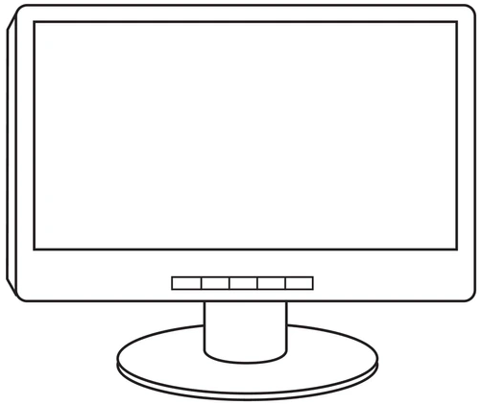
1. Software Requirement
LabVIEW
STM32
Control firmware.
Monitor sensor signals.
01010101
Generate triggers & pulses.
Read sensor signals.
Execute commands.
Trigger Line
Pulse Line
Sensor Board
Coils
Current Amplifier
Commands & Data Line

Slide 4
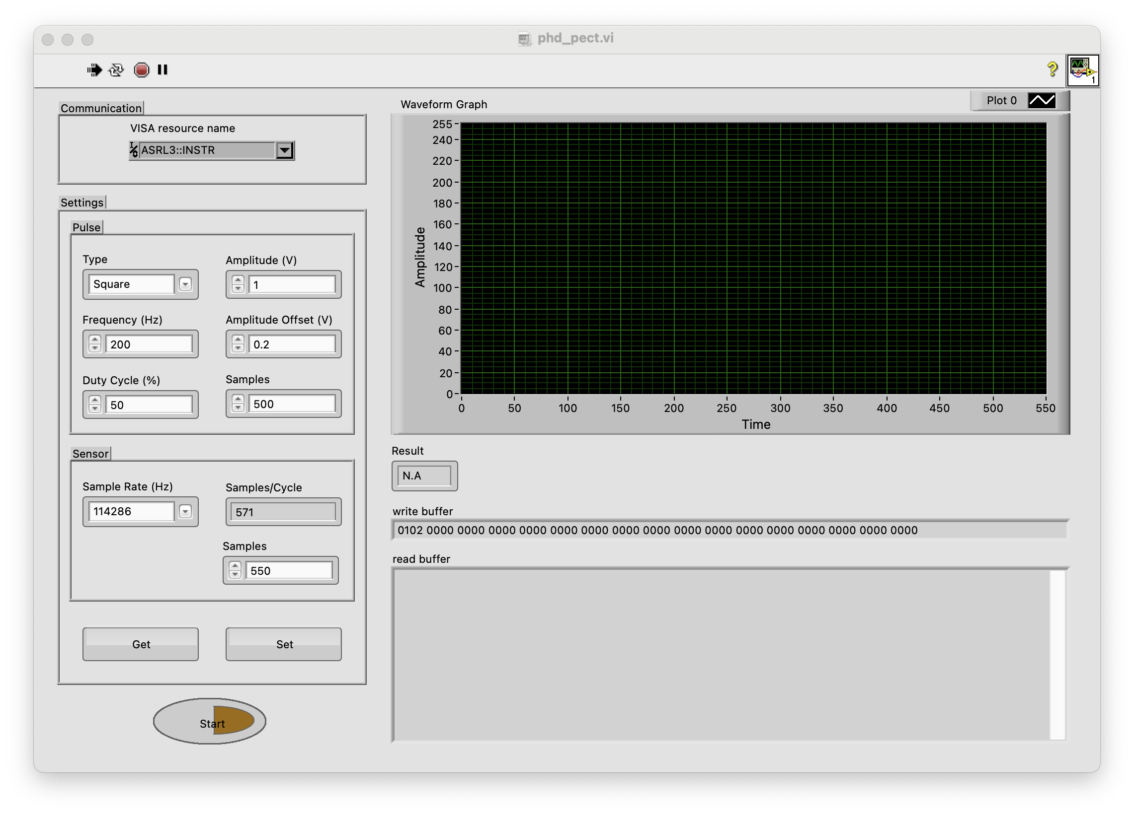
2. LabVIEW Design – Front Panel
Control firmware
Monitor sensor signals

Slide 5
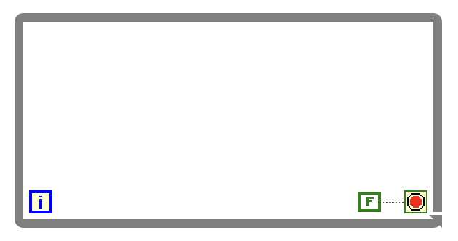
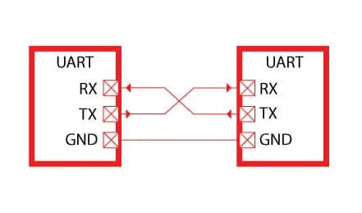
2. LabVIEW Design – Block Diagram
Two loops to process parallel.
Writing:
Send commands from LabVIEW to Firmware
Reading:
Read responses from Firmware.
Read data from Firmware.
Reading Loop
Writing Loop

Slide 6
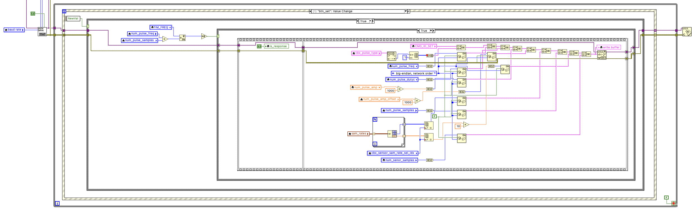
2. LabVIEW Design – Block Diagram
Writing loop:
Convert a 32 bit integer to an array of 4 bytes by “Flatten to String” object.

Slide 7
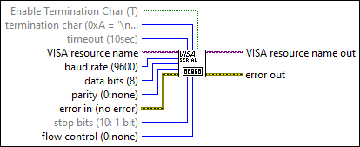
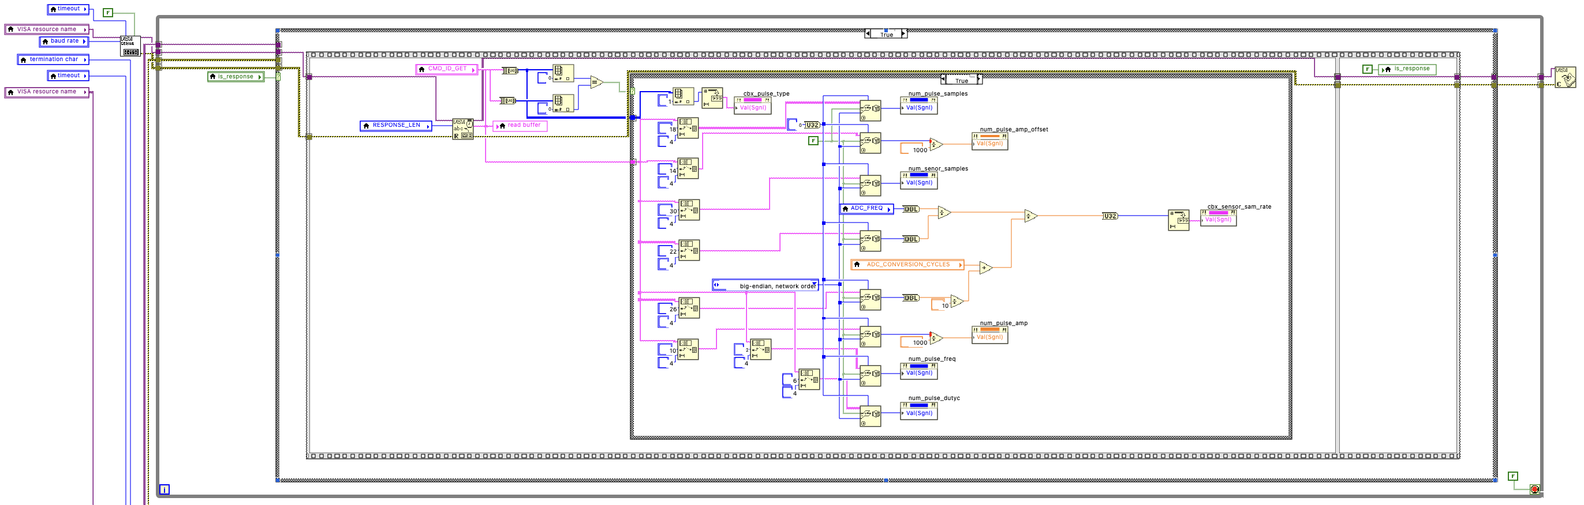
2. LabVIEW Design – Block Diagram
Reading loop:
Consider use “VISA Read” with or without Termination Char.
With Termination Char: LabVIEW can read bytes array fast but the bytes array cannot contain the Termination Char.
Apply this solution to read sensor samples.
Each sensor sample is 1 byte and greater than 0x00. Choose ADC with resolution 8 bit.
Choose Termination Char as 0x00.
Without Termination Char: LabVIEW reads bytes array slow but the bytes array can contain the Termination.
Apply this solution to read response.
Convert an array of 4 bytes to a 32 bit integer by “Unflatten from String” object.

Slide 8
3. Firmware Design
Generate triggers & pulses
Read sensor signals
Execute commands
Run AI model

Slide 9
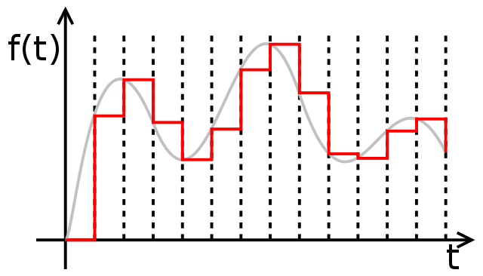


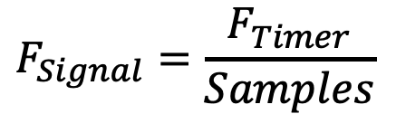

3. Firmware Design – Generate Triggers & Pulses
Use Timer, DAC and DMA.
Actual signal
$$F_{Signal}=\frac{F_{Timer}}{Samples}$$
Expected signal
$${Value}_{DAC}$$
$$T_{Timer}$$
$$T_{Signal}$$

Slide 10


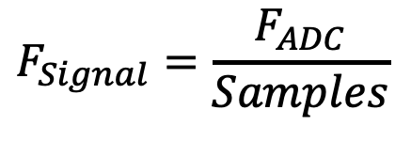

3. Firmware Design – Read Sensor Signals
Use ADC and DMA.
Digital signal
$$F_{Signal}=\frac{F_{ADC}}{Samples}$$
Analog signal
$${Value}_{ADC}$$
$${Sampling Time}_{ADC}$$
$$T_{Signal}$$

Slide 11
3. Firmware Design – Read Sensor Signals
Use ring buffer to store sensor data.
Next writen buffer
Writing Buffer
Reading Buffer
DMA
ADC
DMA
UART

Slide 12
3. Firmware Design – Read Sensor Signals
There is trigger interrupt and ADC completed reading N samples
CPU starts ADC and DMA to read N samples
DMA copies N samples to a buffer
ADC reads N samples
There is UART completed transmission interrupt
CPU starts DMA and UART to transmit N samples to LabVIEW
DMA copies N samples to UART
UART transmits N samples to LabVIEW
Sequence to read sensor signals
Sequence to transmitt sensor signals to LabVIEW

Slide 13
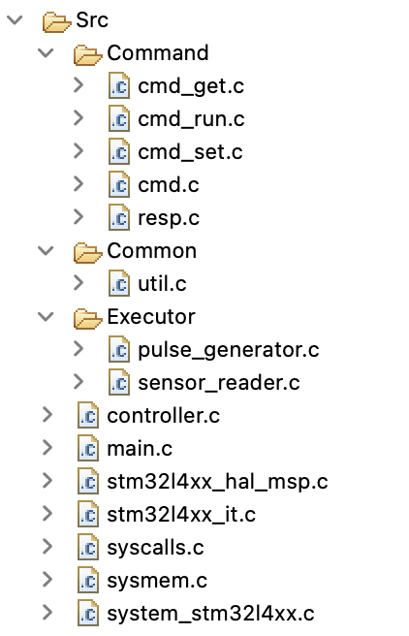
3. Firmware Design – Execute Commands
Execute and make response for the Get command
Execute and make response for the Run command
Execute and make response for the Set command
Generate triggers and pulses
Read sensor signals
Initialize all executors, receive commands and request the low layers to execute commands
“Controller” receives a command via UART.
Firmware will ignore all new command while it is processing a command.
“Controller” parse the command and create the command object (cmd_get, cmd_run or cmd_set)
“Controller” requests the command object to execute and make response
“Controller” transmits response to LabVIEW
Firmware is ready to receive the new command.

Slide 14
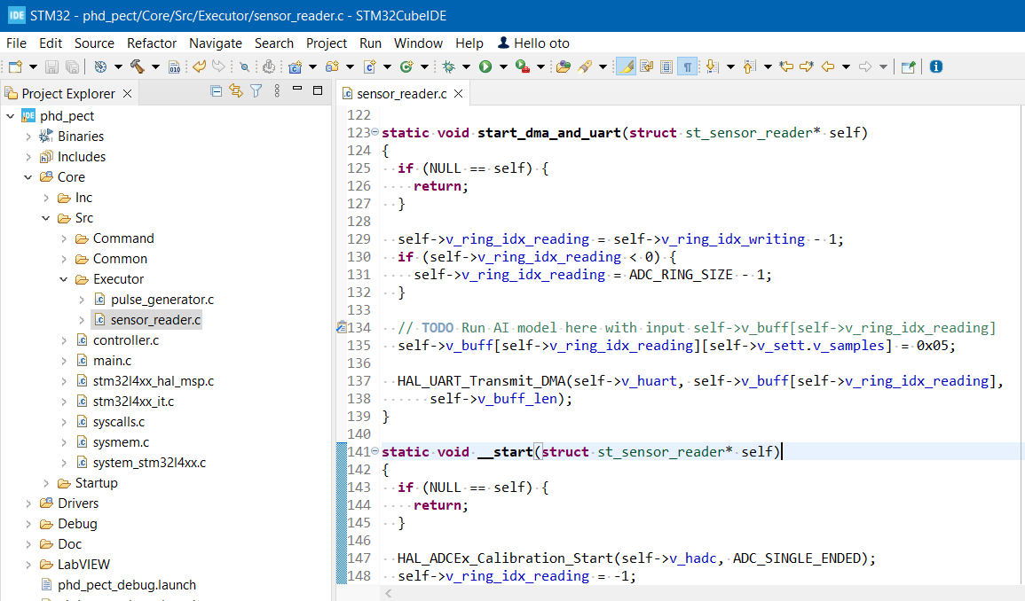
3. Firmware Design – Run AI Model

Slide 15
Thank you.

Slide 16
Pins Configuaration
Pulse Out
Pin Label | Pin Name | Connector-Pin
Trigger Out | PA4 | CN7-Pin9
Pulse Out | PA5 | CN7-Pin10
Trigger In | PG0 | CN9-Pin29
Pulse In | PC0 | CN9-Pin3
Trigger Out
Trigger In
Pulse In

Slide 17
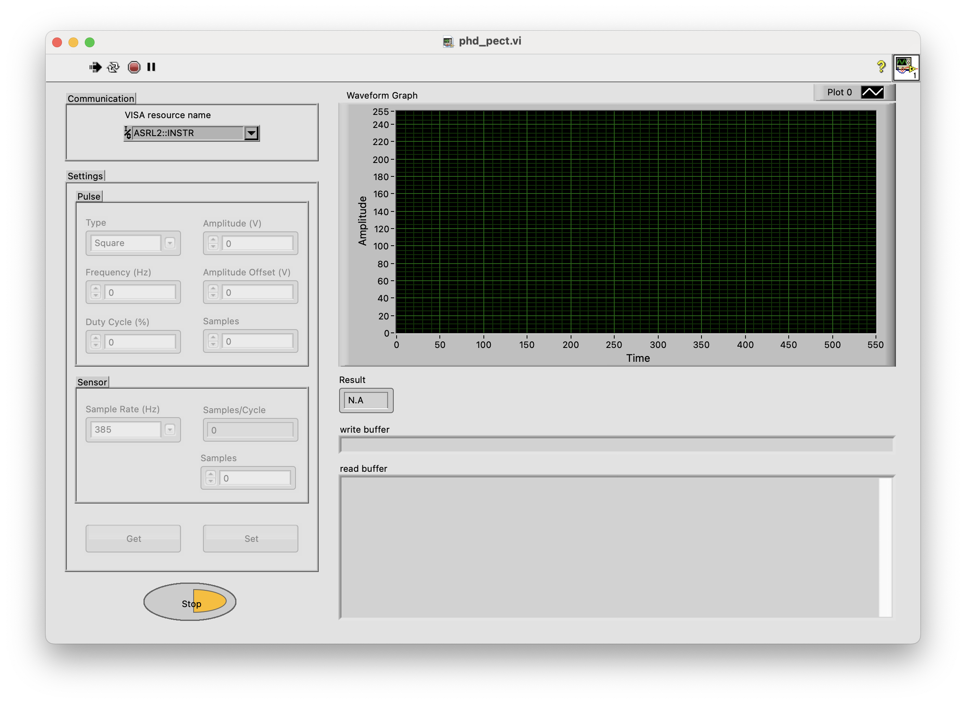
LabVIEW Manual
Step 1: Open the LabVIEW program, user will have to press the [Stop] button to send Stop command to Firmware to make sure that the Firmware stopped generating and reading signals.

Slide 18

LabVIEW Manual
Step 2: Press [Get] button to get settings from the Firmware.
Step 3: If user wants to change the settings in Firmware then press [Set] button.
Step 4: Press [Start] button to read sensor signals.
Step 5: Before close the LabVIEW program, user needs to press [Stop] button to make the Firmware stopped generating and reading signals.

